Slide 1


Big Data Infrastructure
CS 489/698 Big Data Infrastructure (Winter 2017)
Week 1: Introduction (2/2)
January 5, 2017
Jimmy Lin
David R. Cheriton School of Computer Science
University of Waterloo
These slides are available at http://lintool.github.io/bigdata-2017w/
This work is licensed under a Creative Commons Attribution-Noncommercial-Share Alike 3.0 United States See http://creativecommons.org/licenses/by-nc-sa/3.0/us/ for details

Slide 2
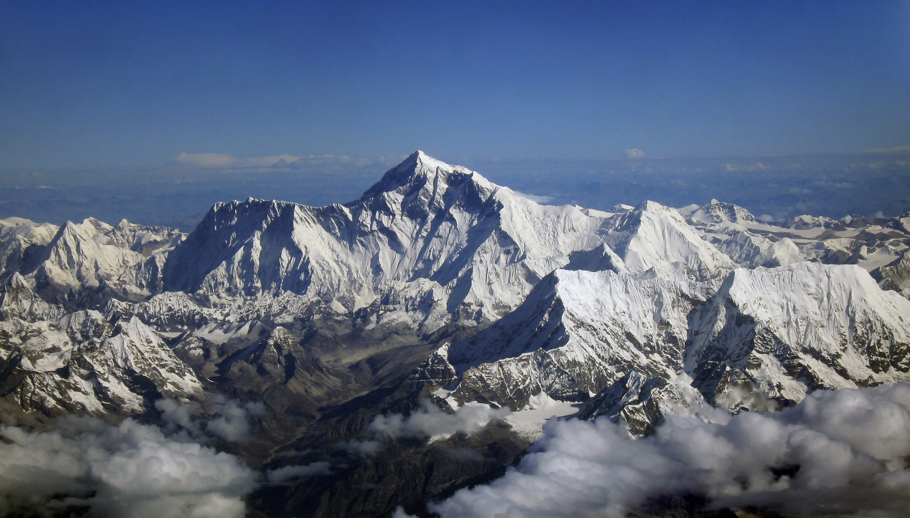
Why big data?
Science
Engineering
Commerce
Society
Source: Wikipedia (Everest)

Slide 3
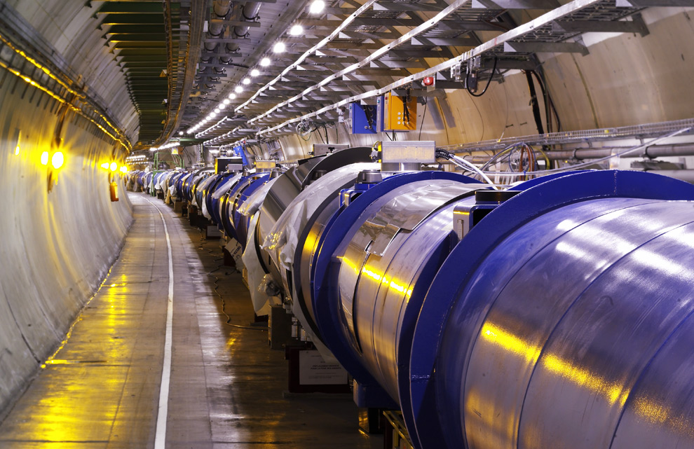
Science
Emergence of the 4th Paradigm
Data-intensive e-Science
Maximilien Brice, © CERN
Notes:
By the time it shuts down in 2011, the CERN collider should have amassed about 20 times as much data as it now has. (NYTimes article, “Trillions of Reasons to Be Excited”, 11/1/2010)

Slide 4
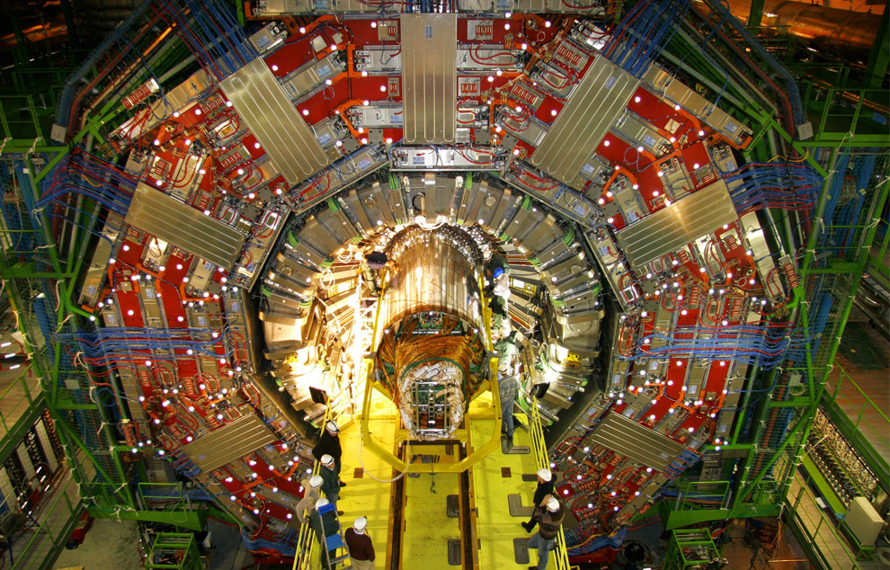
Maximilien Brice, © CERN

Slide 5
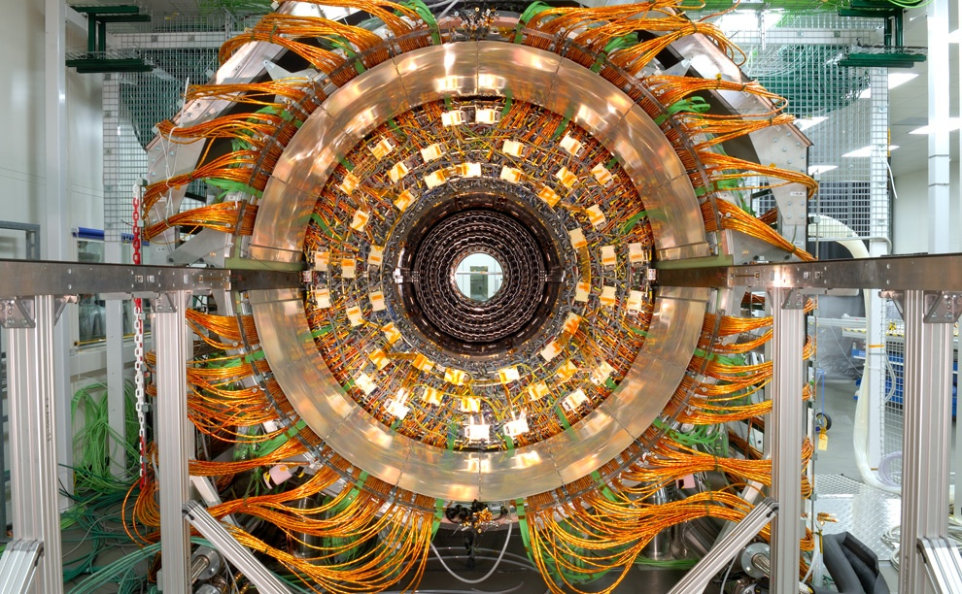
Maximilien Brice, © CERN

Slide 6
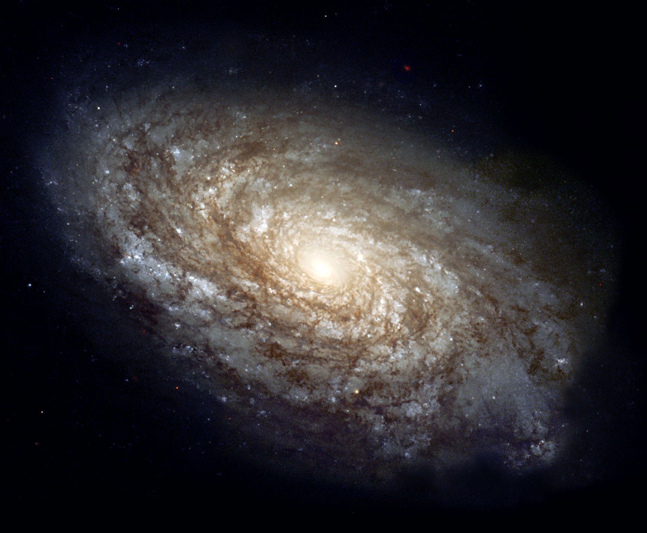
Source: Wikipedia (Galaxy)

Slide 7
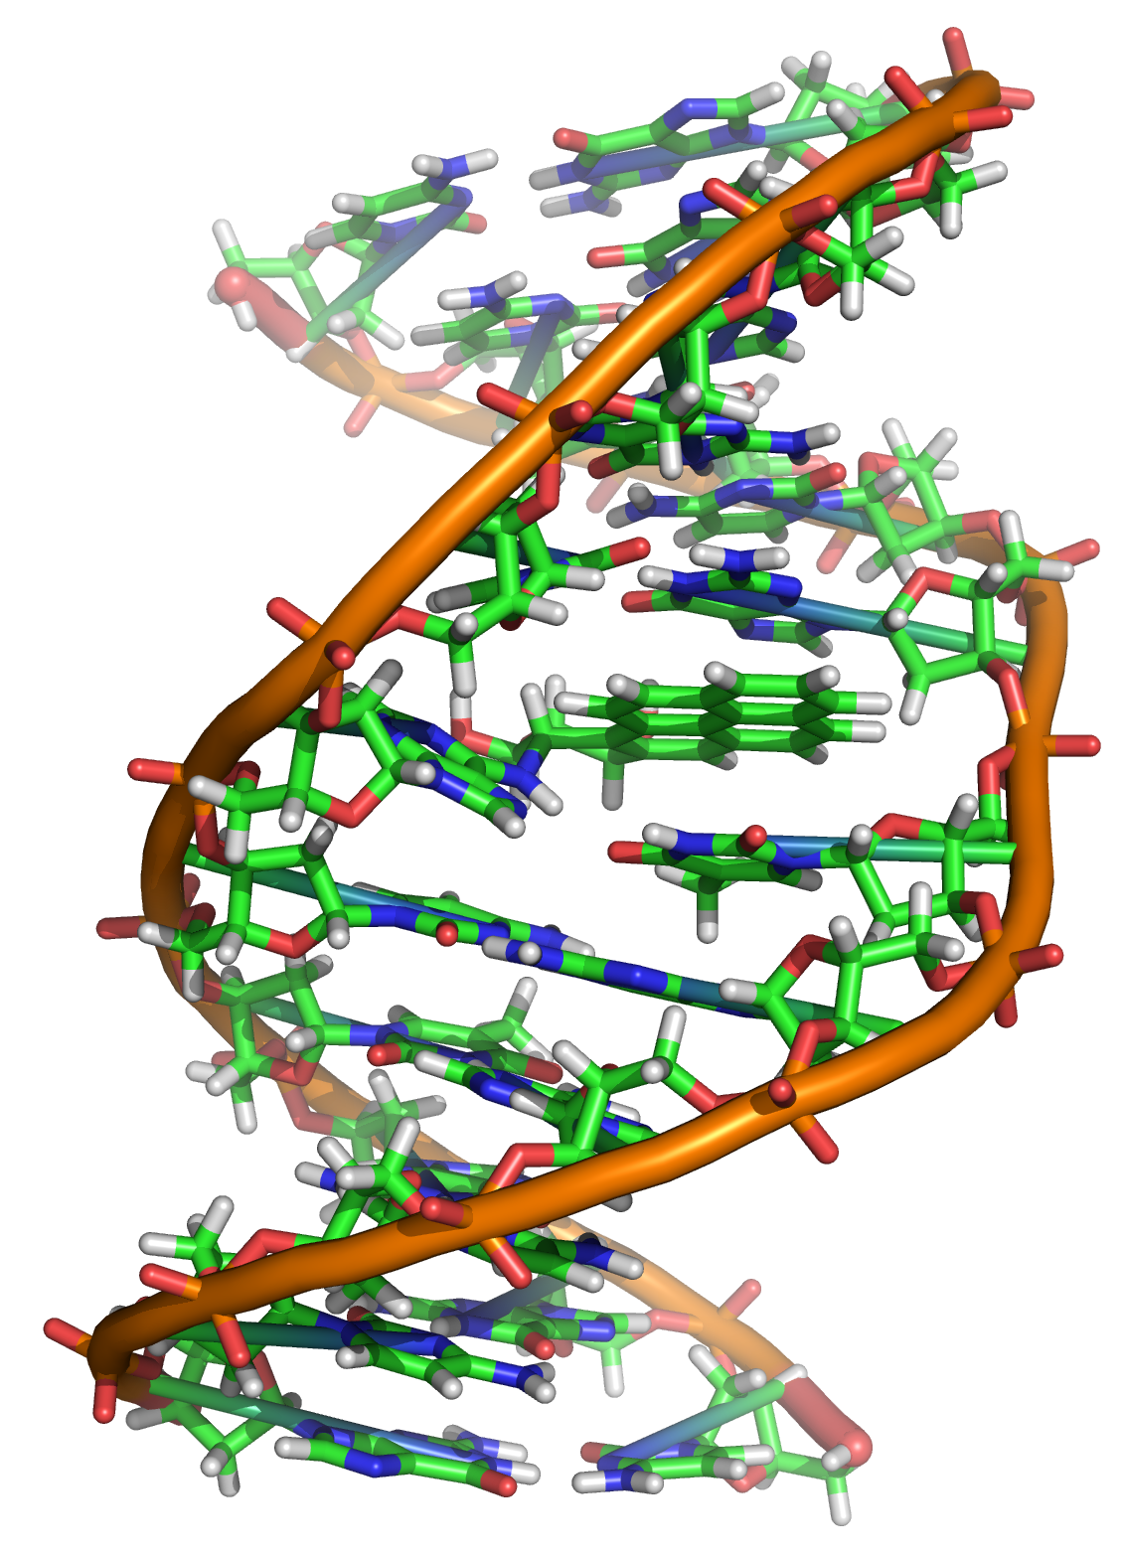
Source: Wikipedia (DNA)

Slide 8
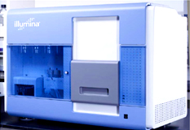
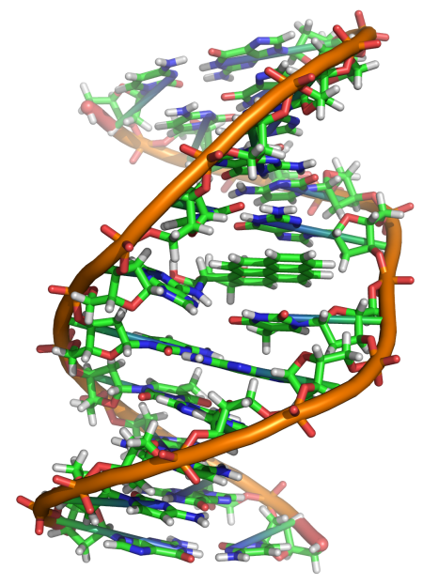
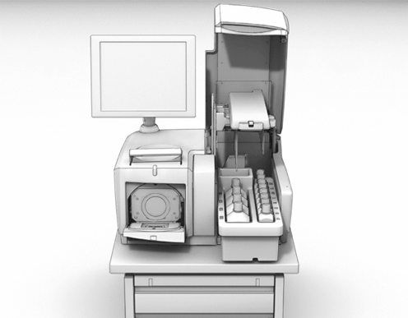
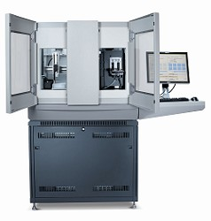
GATGCTTACTATGCGGGCCCC
CGGTCTAATGCTTACTATGC
GCTTACTATGCGGGCCCCTT
?
AATGCTTACTATGCGGGCCCCTT
TAATGCTTACTATGC
AATGCTTAGCTATGCGGGC
AATGCTTACTATGCGGGCCCCTT
AATGCTTACTATGCGGGCCCCTT
CGGTCTAGATGCTTACTATGC
AATGCTTACTATGCGGGCCCCTT
CGGTCTAATGCTTAGCTATGC
ATGCTTACTATGCGGGCCCCTT
Reads
Subject genome
Human genome: 3 gbp
A few billion short reads (~100 GB compressed data)
Sequencer

Slide 9
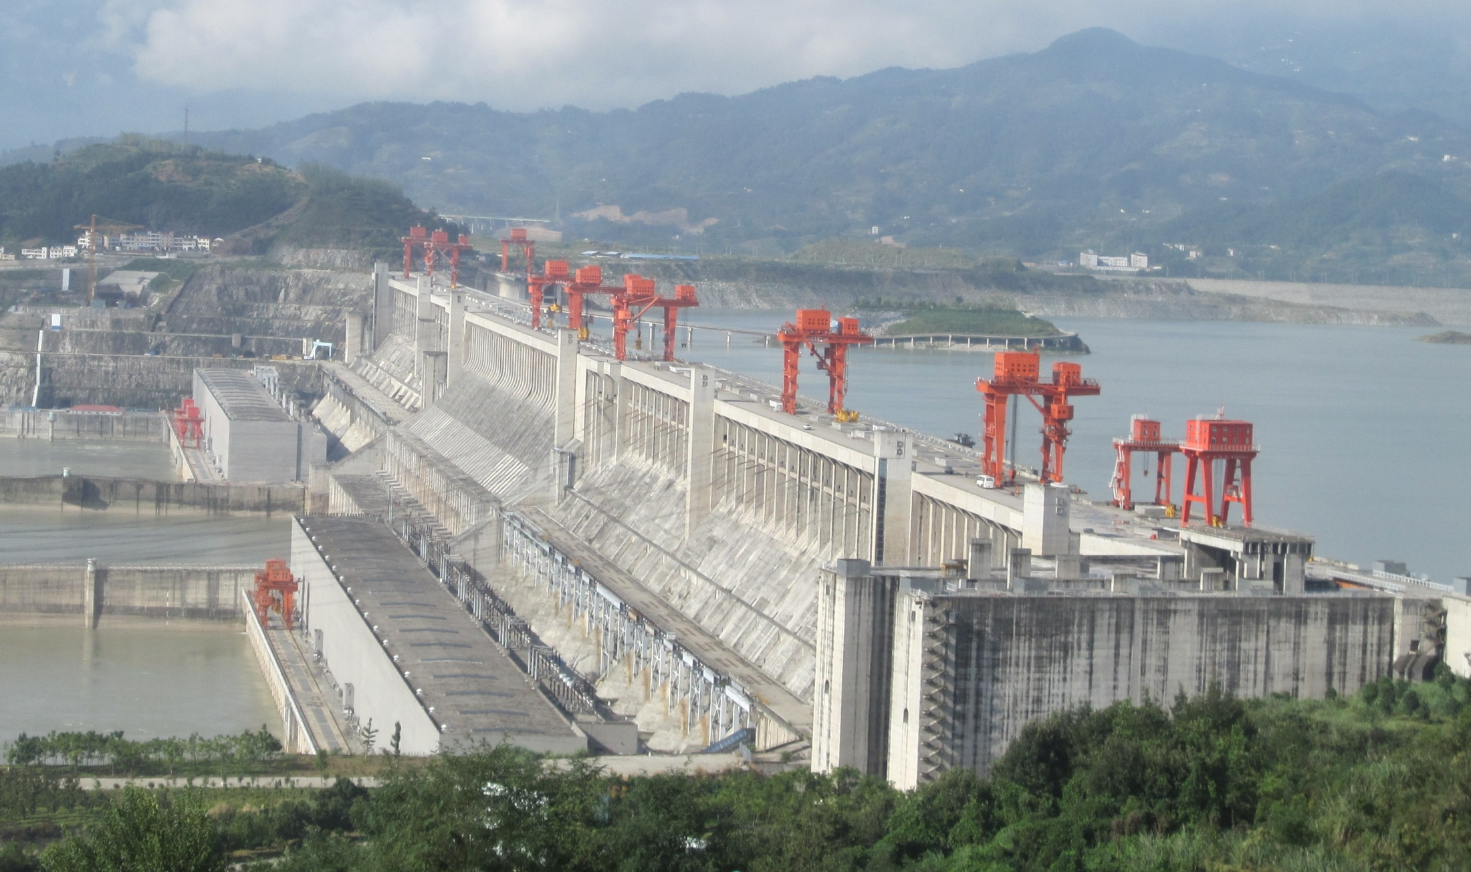
Engineering
The unreasonable effectiveness of data
Search, recommendation, prediction, …
Source: Wikipedia (Three Gorges Dam)

Slide 10
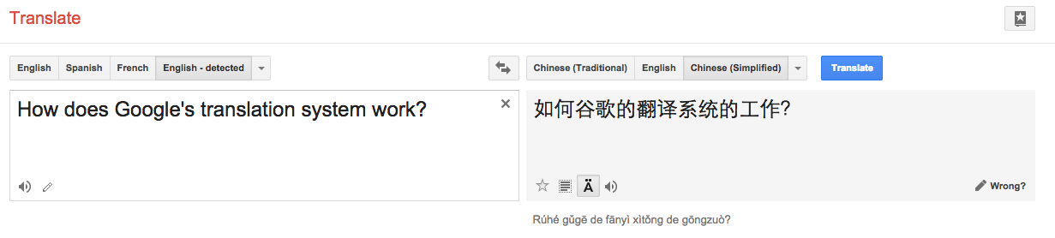

Slide 11
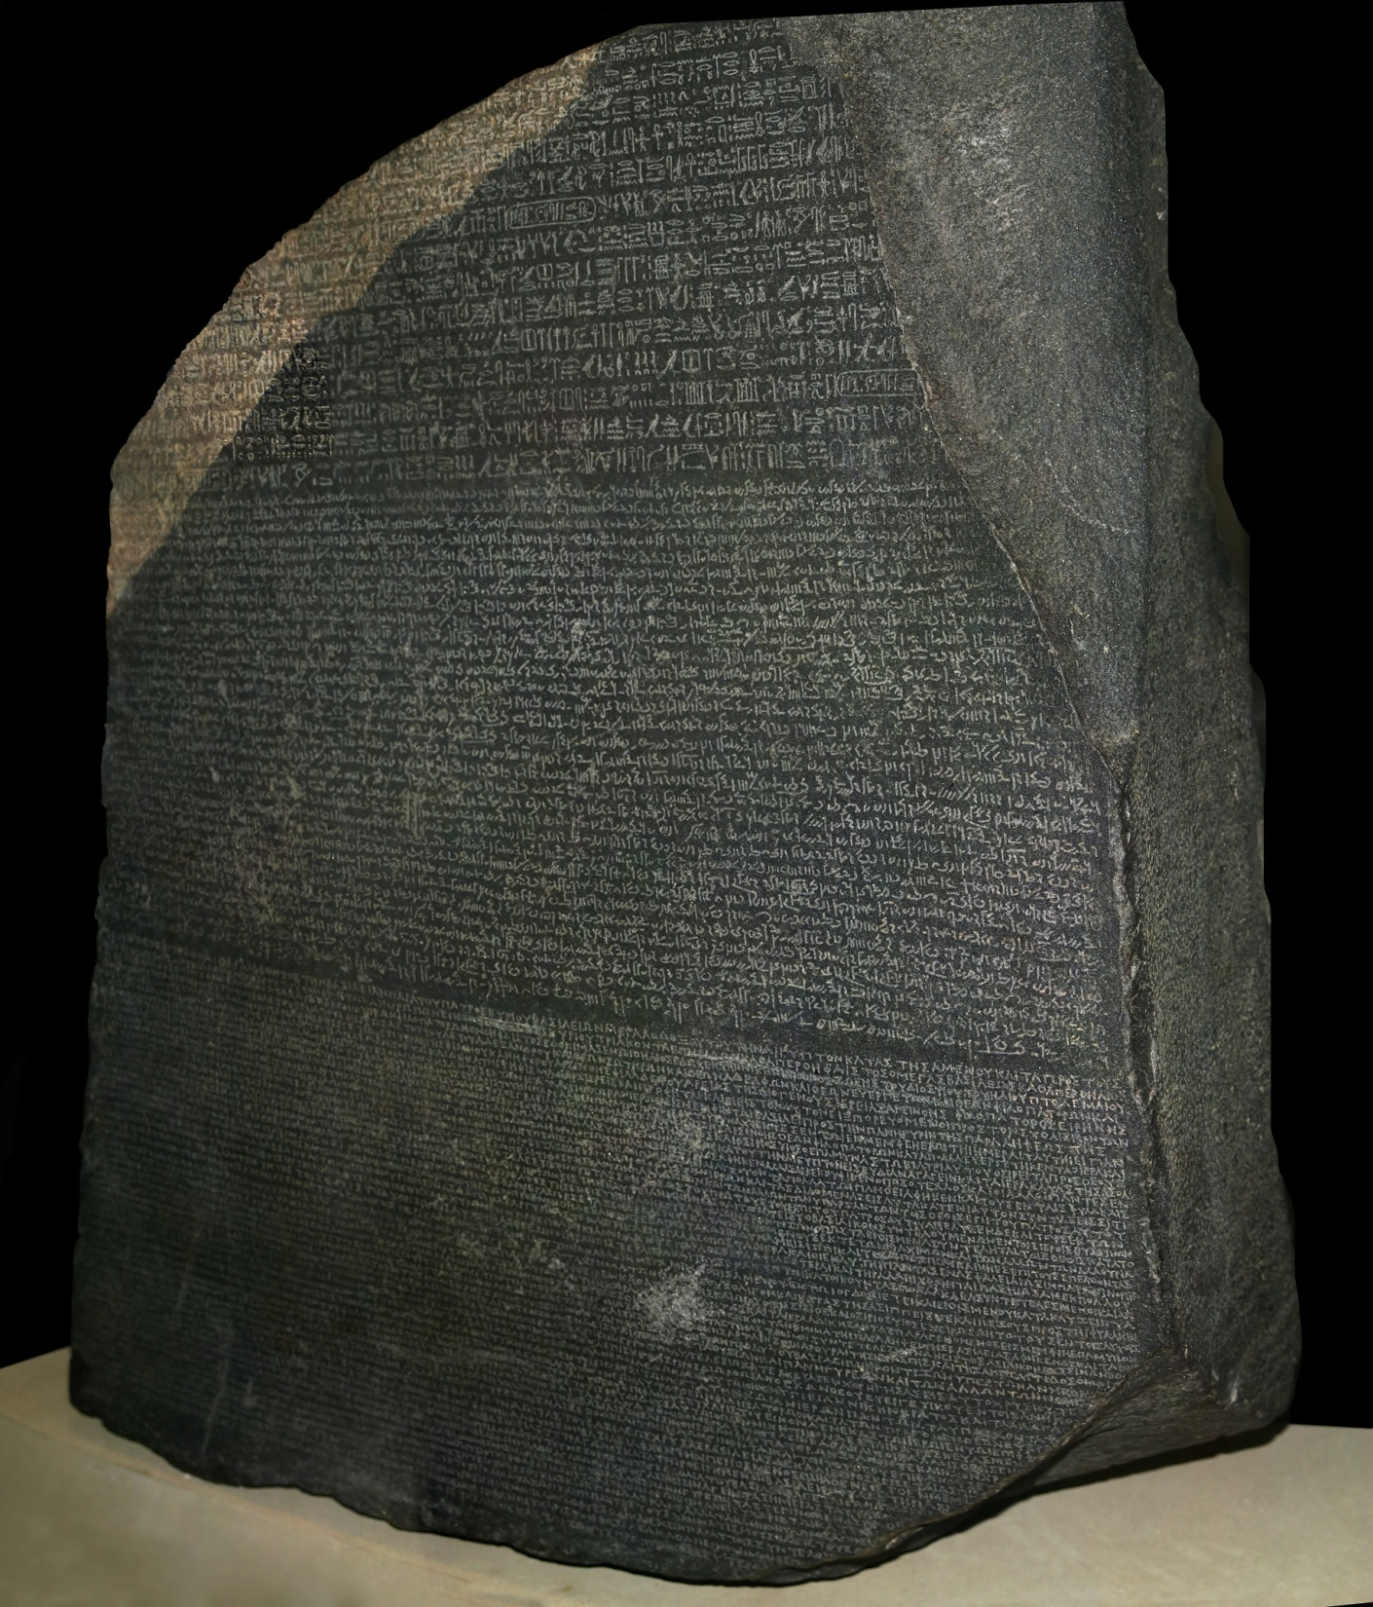
Source: Wikipedia (Rosetta Stone)

Slide 12
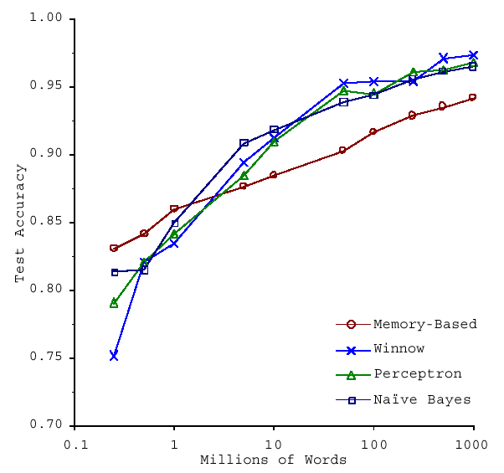
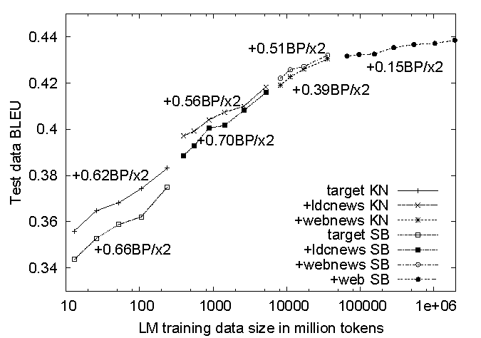
No data like more data!
(Banko and Brill, ACL 2001)
(Brants et al., EMNLP 2007)

Slide 13
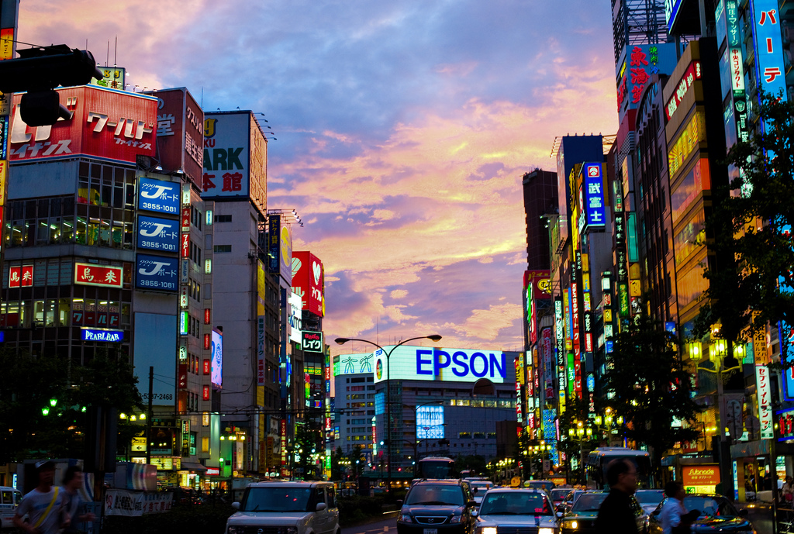
Commerce
Know thy customers
Data → Insights → Profit!
Source: Wikiedia (Shinjuku, Tokyo)

Slide 14
Business Intelligence
An organization should retain data that result from carrying out its mission and exploit those data to generate insights that benefit the organization, for example, market analysis, strategic planning, decision making, etc.
Duh!?

Slide 15
Virtuous Product Cycle
a useful service
$ (hopefully)
transform insights into action
analyze user behavior to extract insights
Google.
Facebook.
Twitter.
Amazon.
Uber.
data products
data science

Slide 16
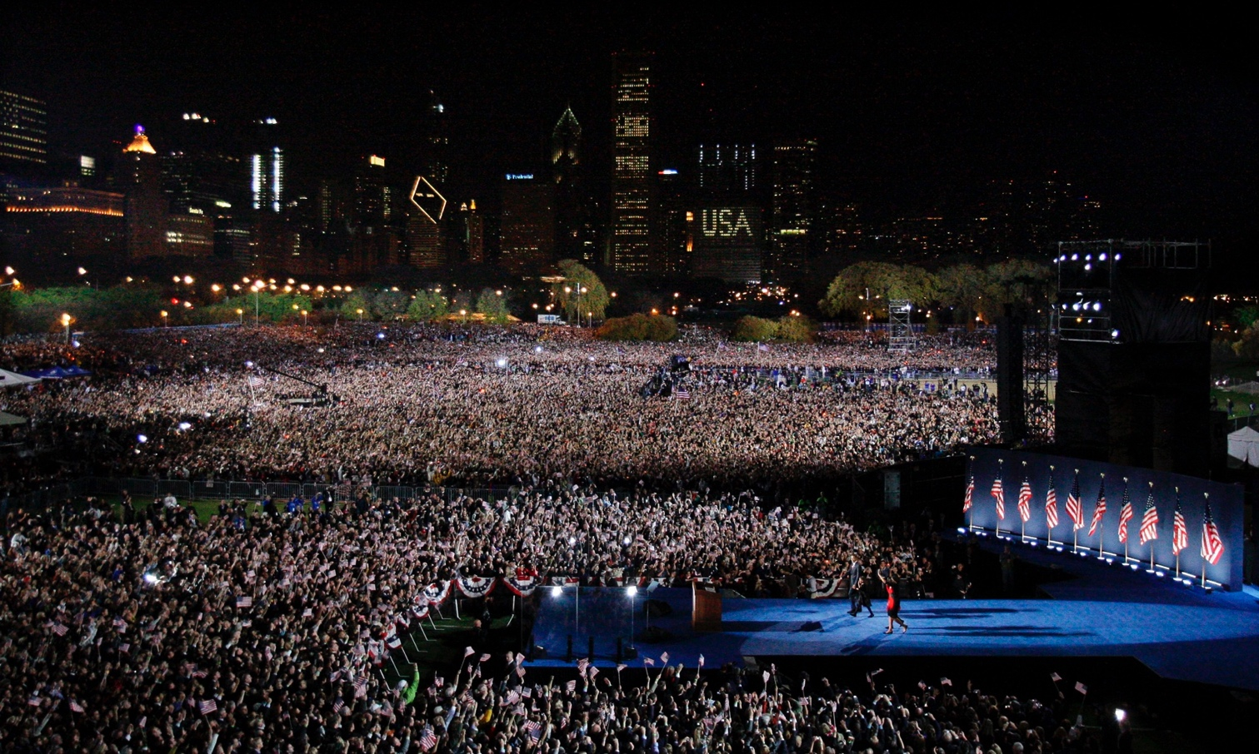
Society
Humans as social sensors
Computational social science
Source: Guardian

Slide 17
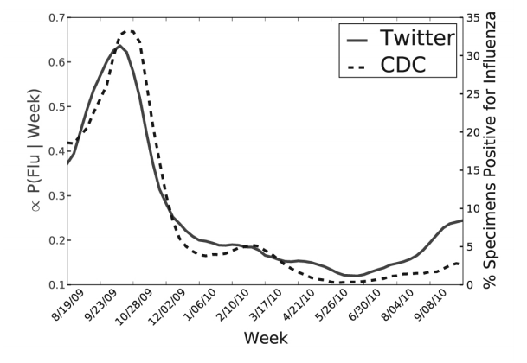
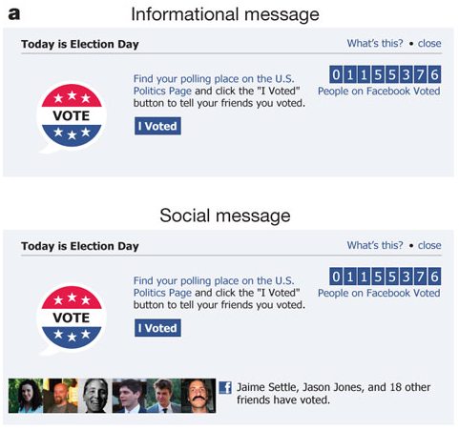
Predicting X with Twitter
2010 US Midterm Elections: 60m users shown “I Voted” Messages
Summary: increased turnout by 60k directly and 280k indirectly
Political Mobilization on Facebook
(Paul and Dredze, ICWSM 2011; Bond et al., Nature 2011)

Slide 18
The Perils of Big Data
The end of privacy
Facebook’s terms of service, large-scale government surveillance
The echo chamber
The polarization of politics and erosion of civility
The racist algorithm
Algorithms aren’t racist, people are?
We desperately need a new “information ethics” to go with big data!

Slide 19
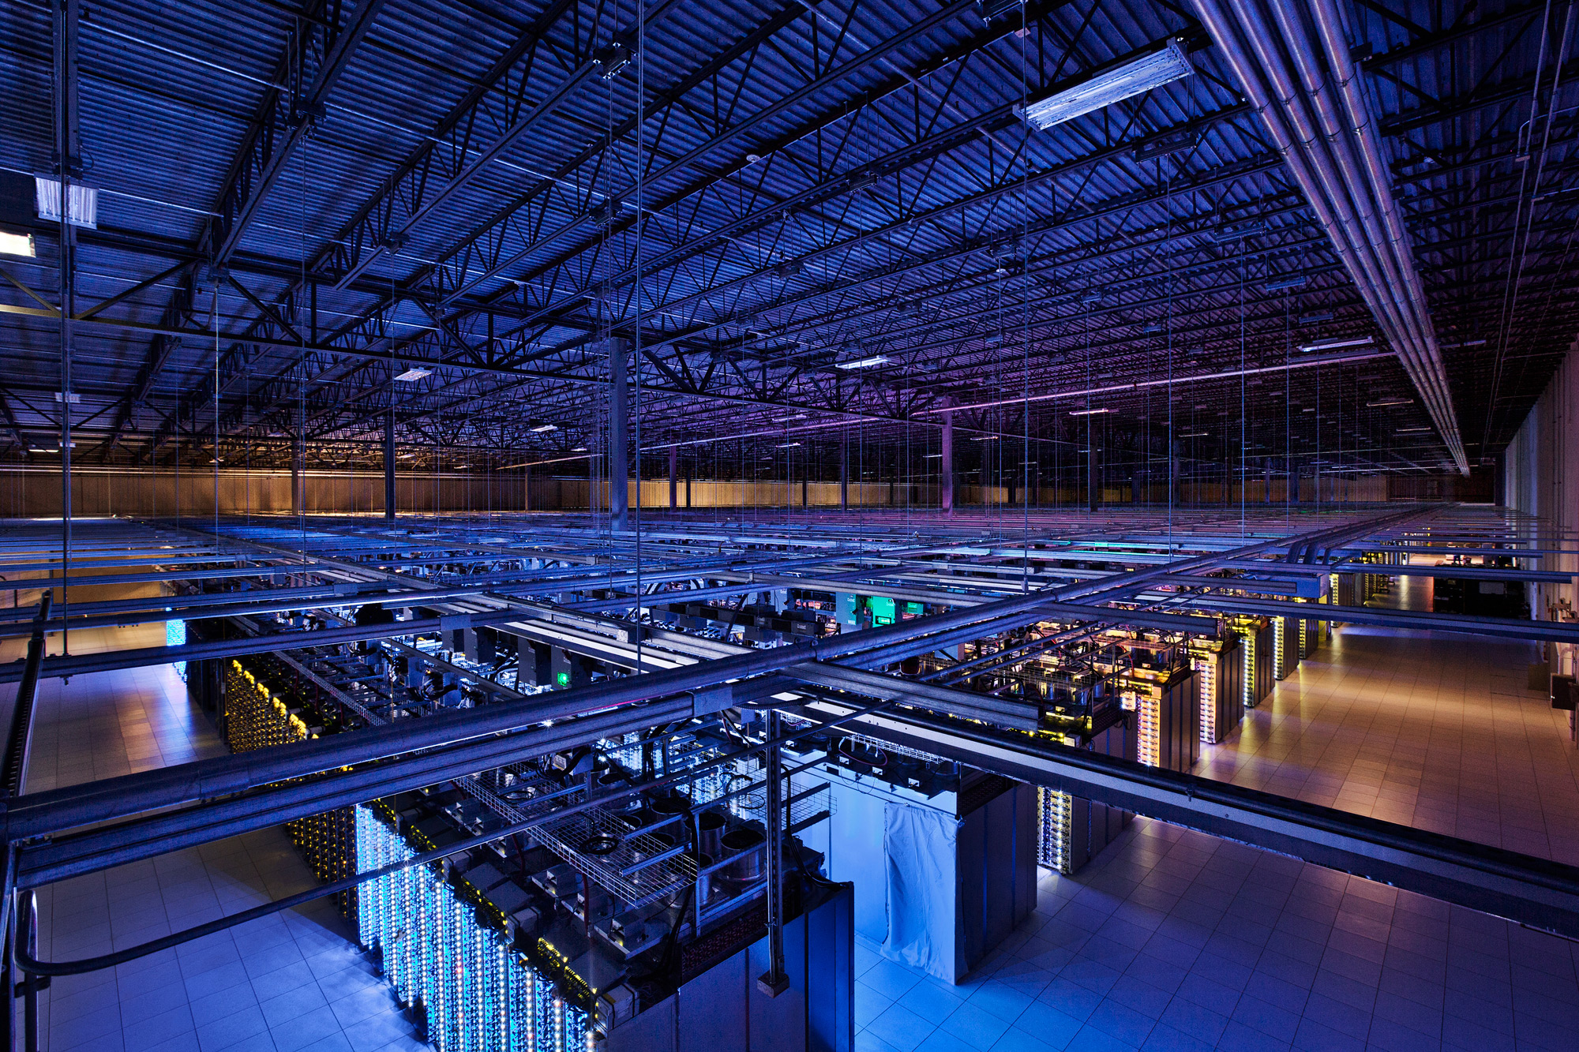
Tackling Big Data
Source: Google

Slide 20
k₁
v₁
k₂
v₂
k₃
v₃
k₄
v₄
k₅
v₅
k₆
v₆
map
map
map
map
a
1
b
2
c
3
c
6
a
5
c
2
b
7
c
8
combine
combine
combine
combine
a
1
b
2
c
9
a
5
c
2
b
7
c
8
partition
partition
partition
partition
Shuffle and Sort: aggregate values by keys
a
1
5
b
2
7
c
c
2
2
9
3
8
6
8
reduce
reduce
reduce
r₁
s₁
r₂
s₂
r₃
s₃

Slide 21
User Program
(1) submit
Master
(2) schedule map
(2) schedule reduce
worker
split 0
(6) write
output
file 0
split 1
(5) remote read
worker
split 2
(3) read
(4) local write
split 3
worker
split 4
worker
output
file 1
worker
Input
files
Map
phase
Intermediate files
(on local disk)
Reduce
phase
Output
files
Adapted from (Dean and Ghemawat, OSDI 2004)

Slide 22
The datacenter is the computer!
It’s all about the right level of abstraction
Moving beyond the von Neumann architecture
What’s the “instruction set” of the datacenter computer?
Hide system-level details from the developers
No more race conditions, lock contention, etc.
No need to explicitly worry about reliability, fault tolerance, etc.
Separating the what from the how
Developer specifies the computation that needs to be performed
Execution framework (“runtime”) handles actual execution
MapReduce is the first instantiation of this idea… but not the last!

Slide 23
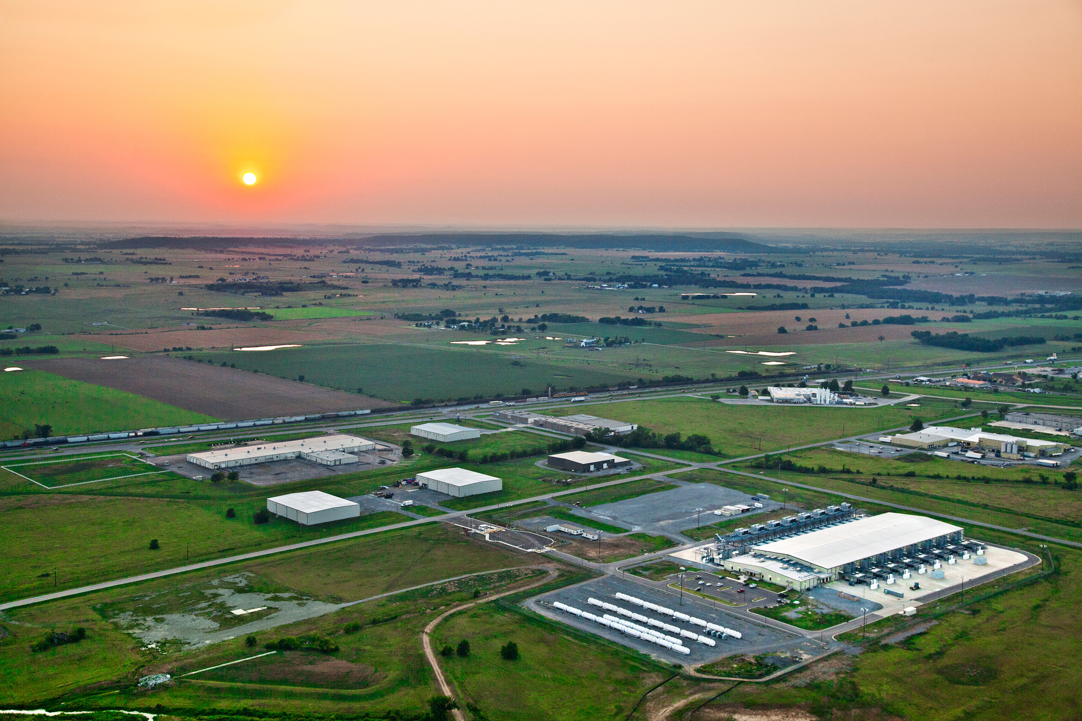
The datacenter is the computer!
Source: Google

Slide 24
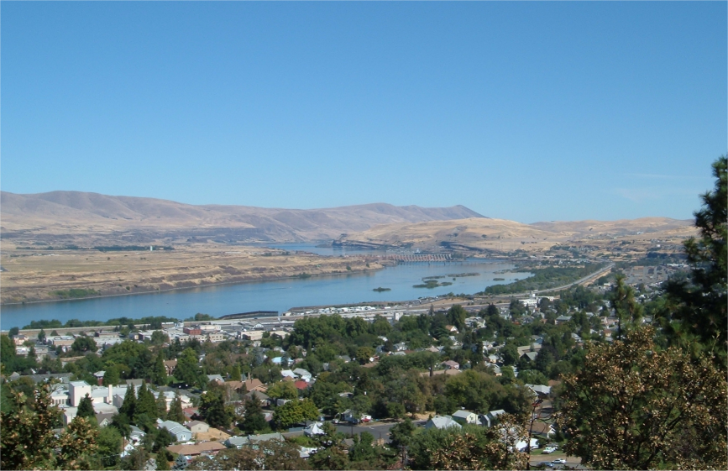
Source: Wikipedia (The Dalles, Oregon)

Slide 25
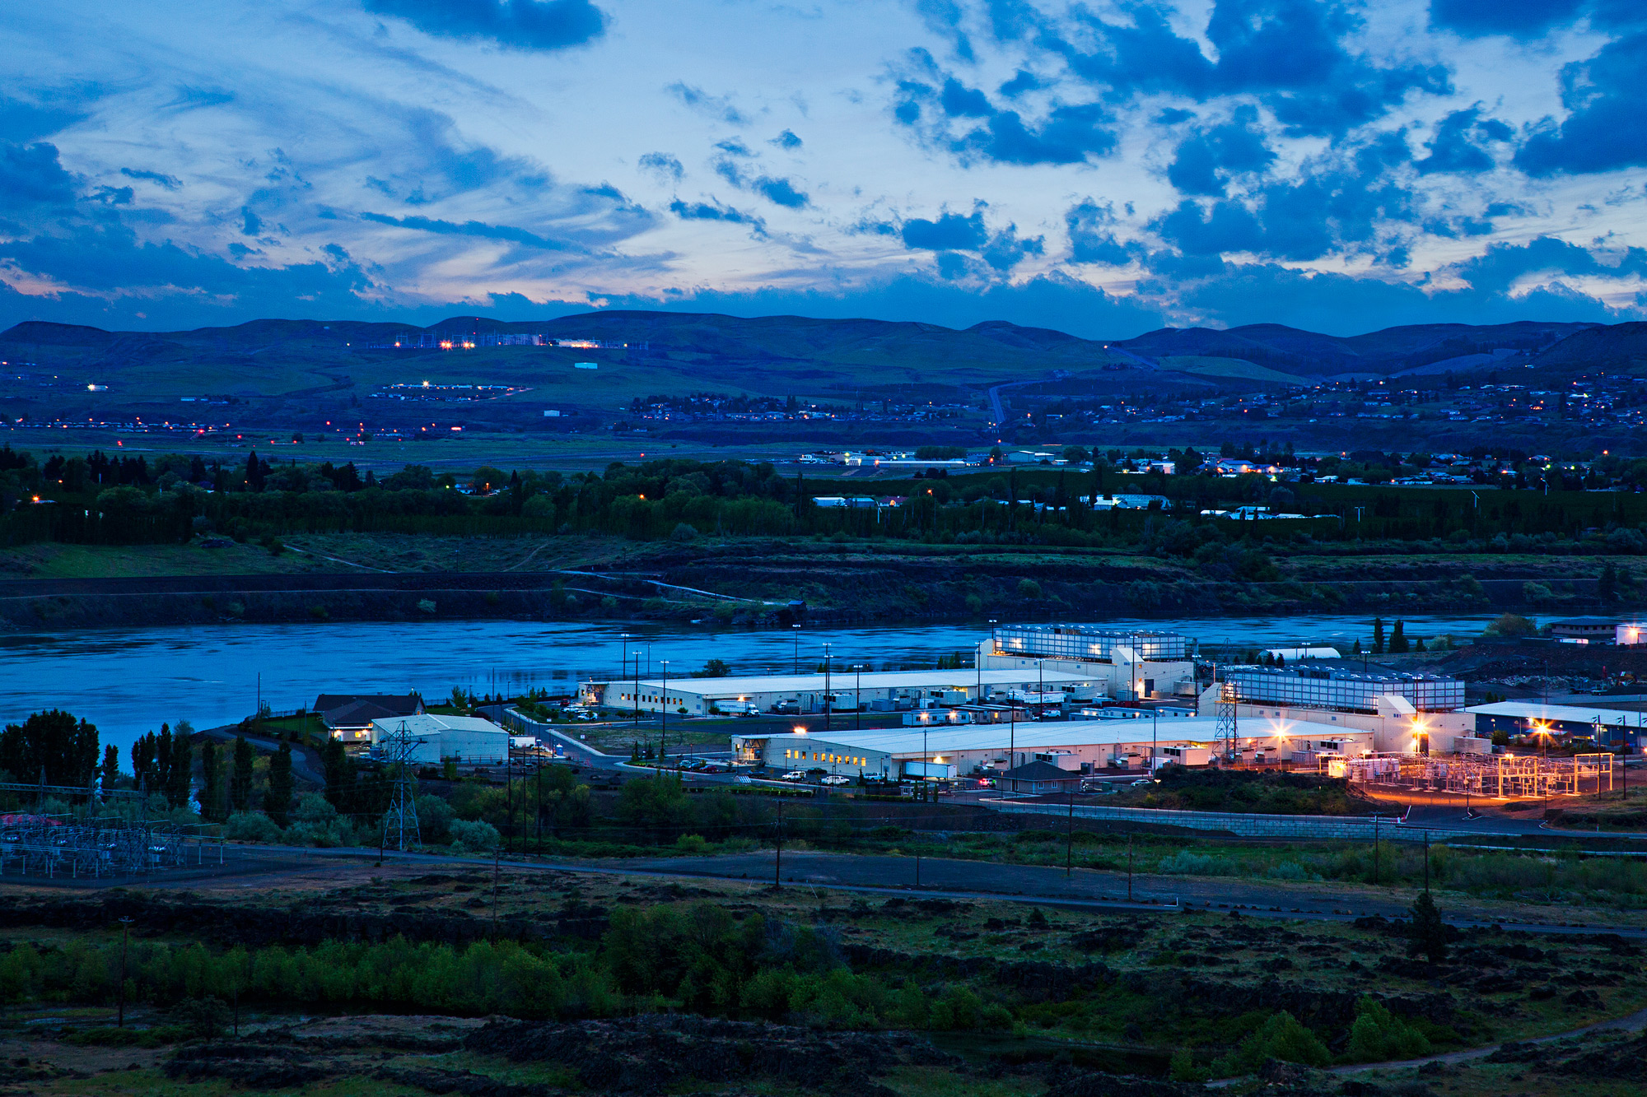
Source: Google

Slide 26
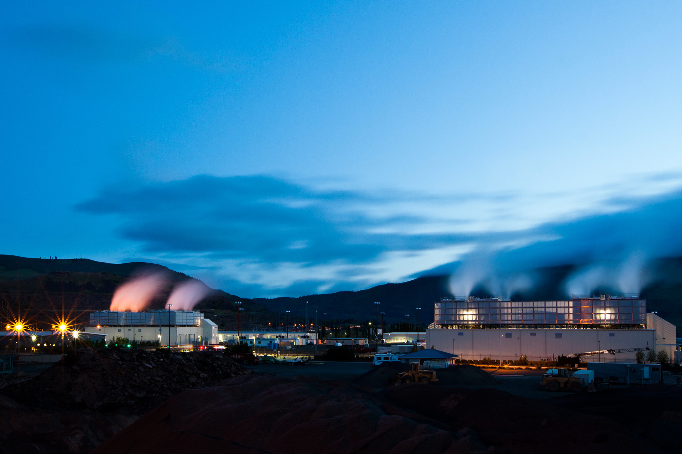
Source: Google

Slide 27
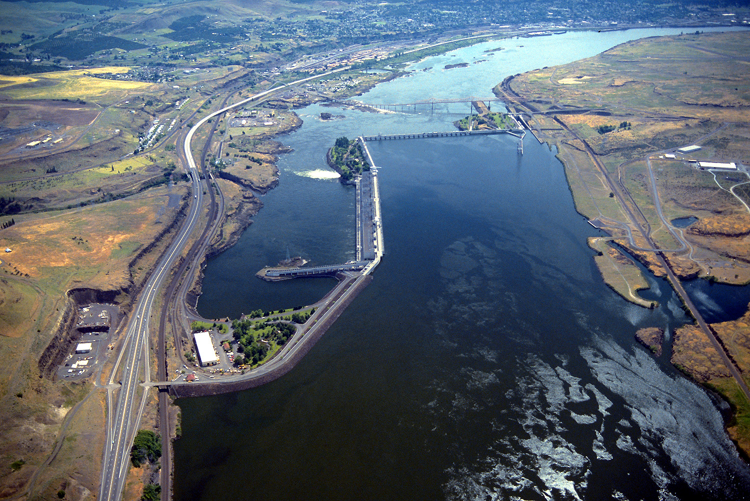
Source: Bonneville Power Administration

Slide 28
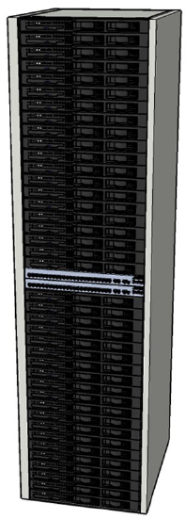
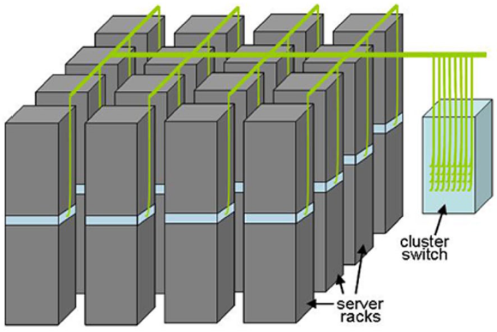
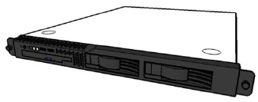
Building Blocks
Source: Barroso and Urs Hölzle (2009)

Slide 29
Source: Google

Slide 30
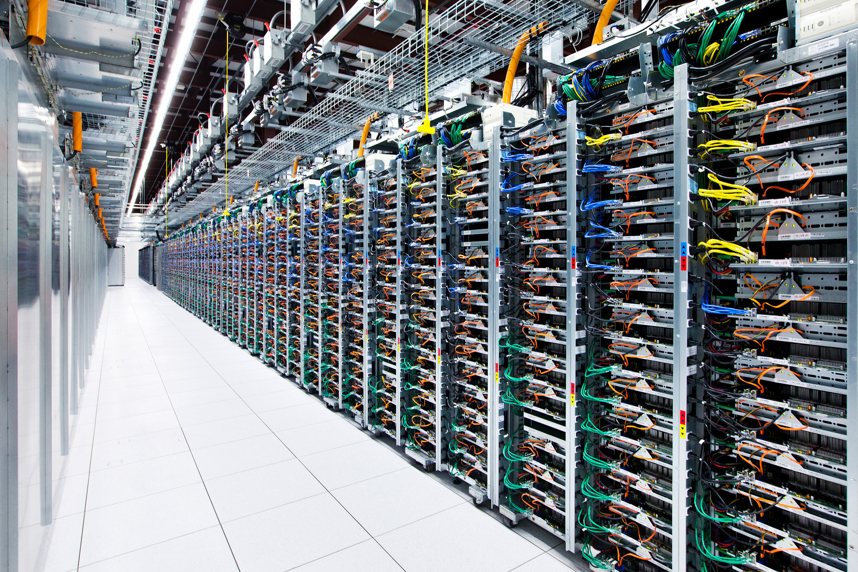
Source: Google

Slide 31
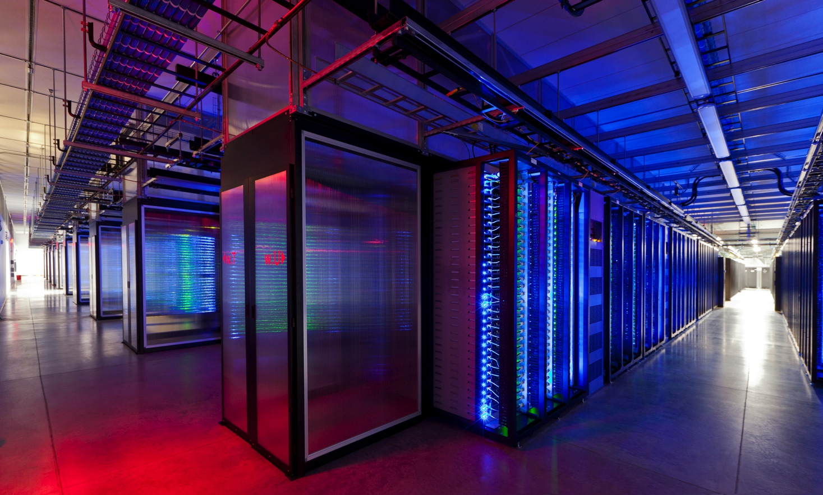
Source: Facebook

Slide 32
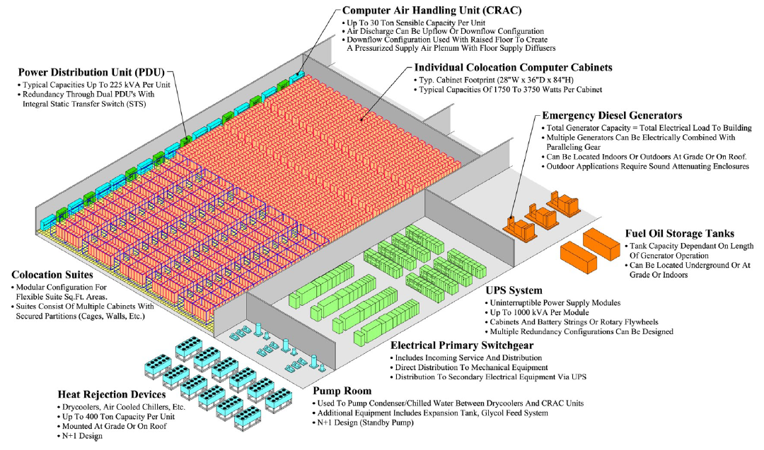
Anatomy of a Datacenter
Source: Barroso and Urs Hölzle (2013)

Slide 33
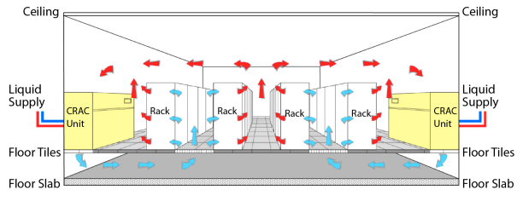
Datacenter cooling
What’s a computer?
Source: Barroso and Urs Hölzle (2013)

Slide 34
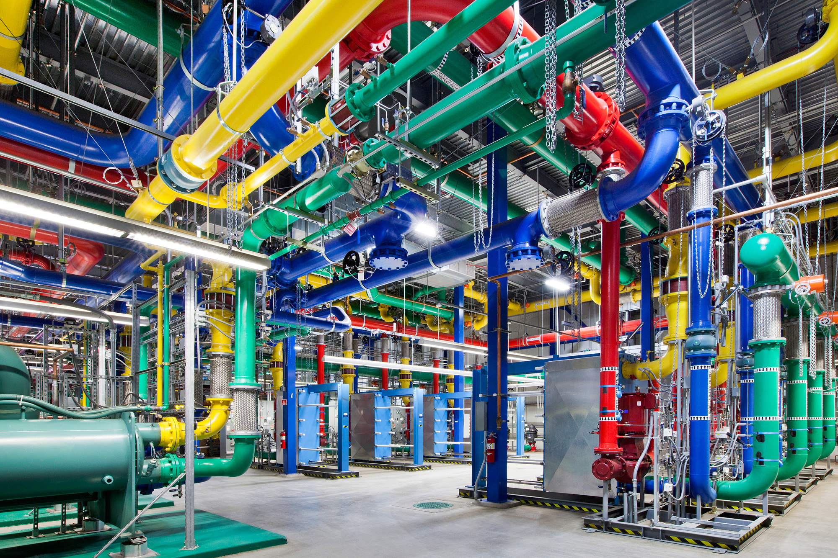
Source: Google

Slide 35
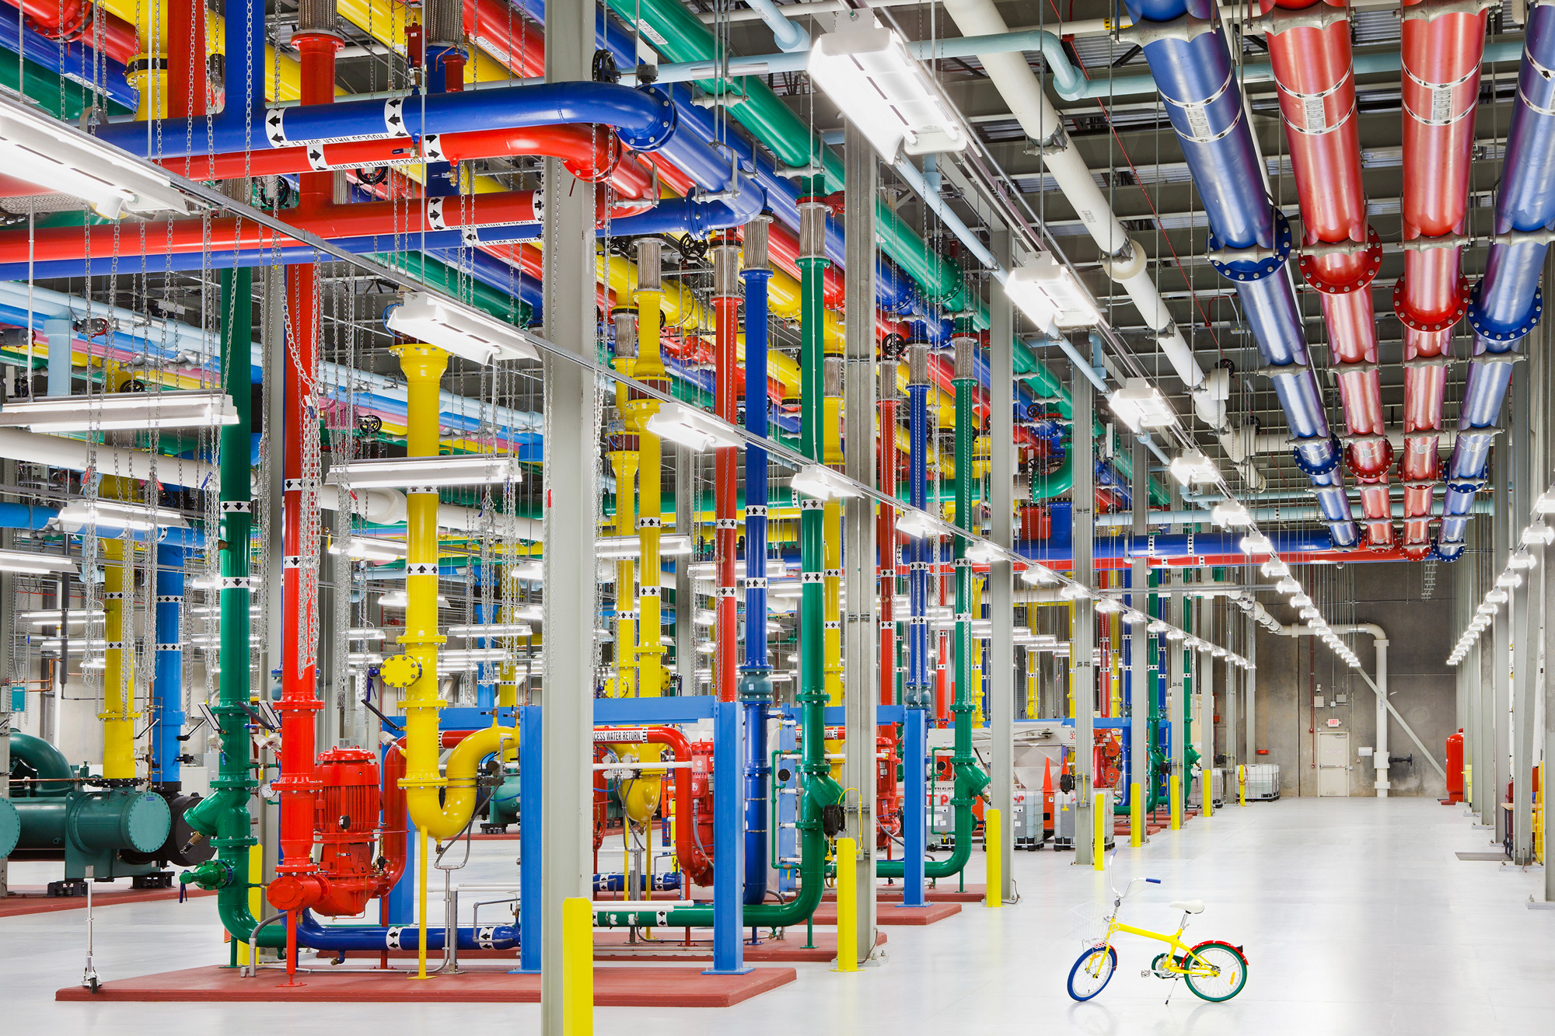
Source: Google

Slide 36
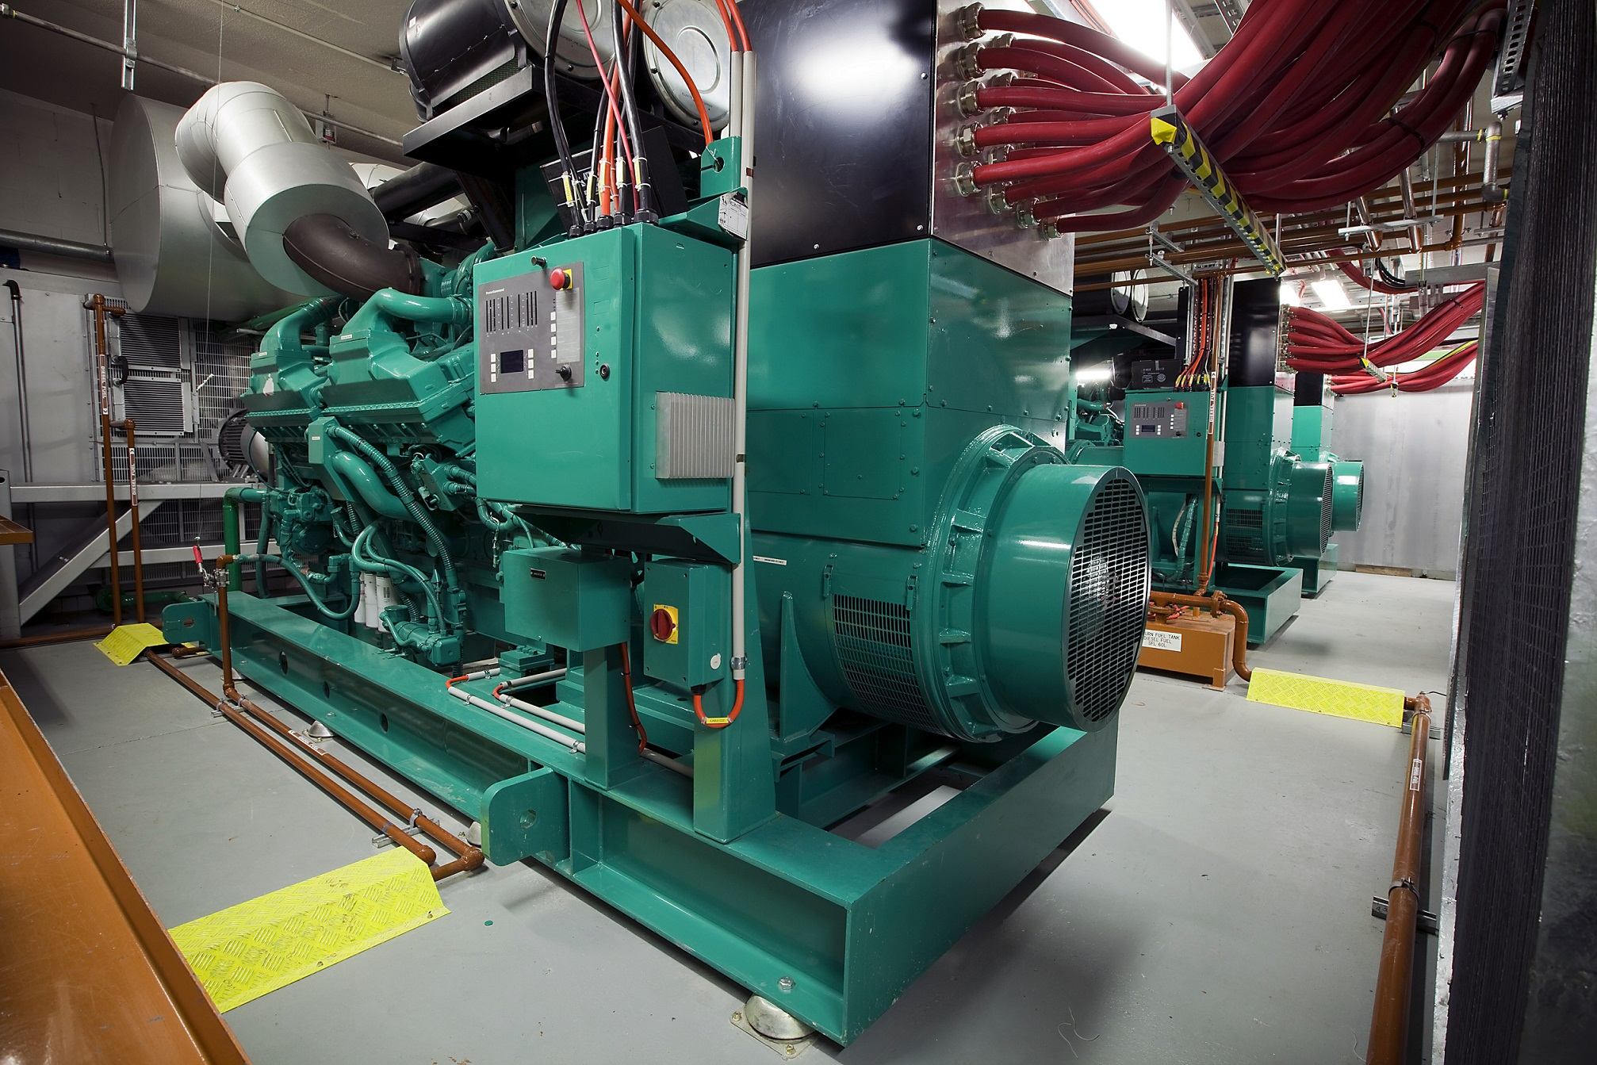
Source: CumminsPower

Slide 37
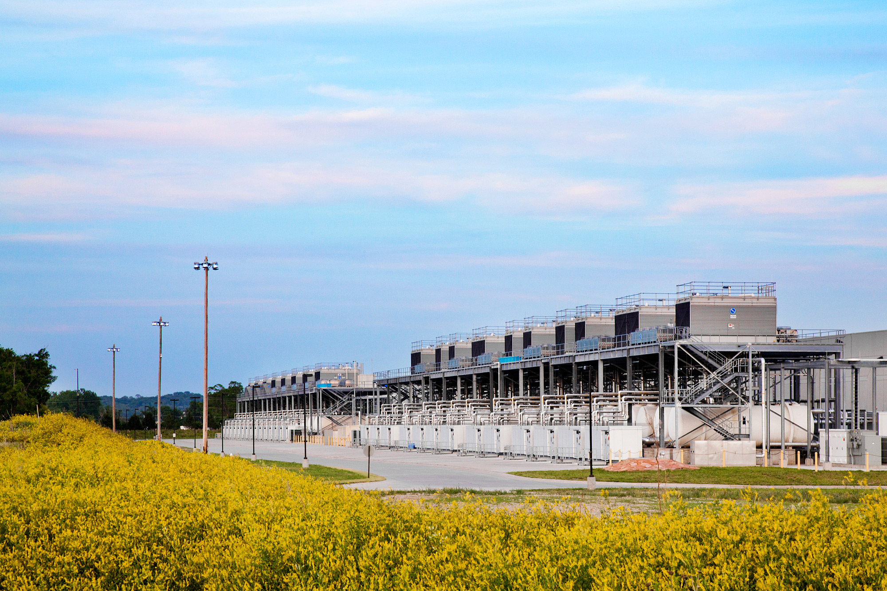
Source: Google

Slide 38
How much is 30 MW?
Source: Google

Slide 39
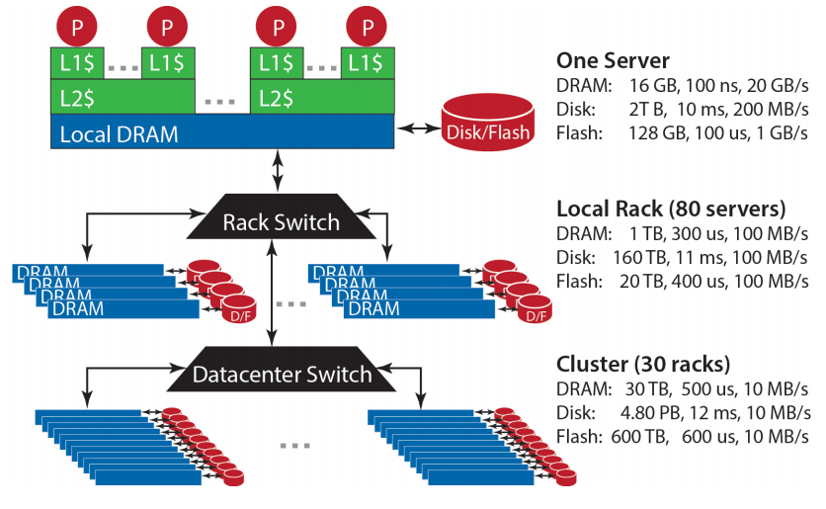
Datacenter Organization
Source: Barroso and Urs Hölzle (2013)

Slide 40
The datacenter is the computer!
It’s all about the right level of abstraction
Moving beyond the von Neumann architecture
What’s the “instruction set” of the datacenter computer?
Hide system-level details from the developers
No more race conditions, lock contention, etc.
No need to explicitly worry about reliability, fault tolerance, etc.
Separating the what from the how
Developer specifies the computation that needs to be performed
Execution framework (“runtime”) handles actual execution
But wait, why do I care?

Slide 41
Intuitions of time and space
How long does it take to read 100 TBs from 100 hard drives?
Now, what about SSDs?
How long will it take to exchange 1b key-value pairs:
Between machines on the same rack?
Between datacenters across the Atlantic?

Slide 42
Storage Hierarchy
Remote Machine
Different Datacenter
Remote Machine
Different Rack
Remote Machine
Same Rack
Local Machine
L1/L2/L3 cache, memory, SSD, magnetic disks
capacity, latency, bandwidth

Slide 43
According to Jeff Dean

Slide 44
The datacenter is the computer!
“Big ideas”
Scale “out”, not “up”
Limits of SMP and large shared-memory machines
Assume that components will break
Engineer software around hardware failures
Move processing to the data
Cluster have limited bandwidth, code is a lot smaller
Process data sequentially, avoid random access
Seeks are expensive, disk throughput is good

Slide 45
Seek vs. Scans
Consider a 1 TB database with 100 byte records
We want to update 1 percent of the records
Scenario 1: Mutate each record
Each update takes ~30 ms (seek, read, write)
108 updates = ~35 days
Scenario 2: Rewrite all records
Assume 100 MB/s throughput
Time = 5.6 hours(!)
Lesson? Random access is expensive!
Source: Ted Dunning, on Hadoop mailing list

Slide 46
The datacenter is the computer!
“Big ideas”
Scale “out”, not “up”
Limits of SMP and large shared-memory machines
Assume that components will break
Engineer software around hardware failures
Move processing to the data
Cluster have limited bandwidth, code is a lot smaller
Process data sequentially, avoid random access
Seeks are expensive, disk throughput is good
Seamless scalability
From the mythical man-month to the tradable machine-hour

Slide 47
k₁
v₁
k₂
v₂
k₃
v₃
k₄
v₄
k₅
v₅
k₆
v₆
map
map
map
map
a
1
b
2
c
3
c
6
a
5
c
2
b
7
c
8
combine
combine
combine
combine
a
1
b
2
c
9
a
5
c
2
b
7
c
8
partition
partition
partition
partition
Shuffle and Sort: aggregate values by keys
a
1
5
b
2
7
c
c
2
2
9
3
8
6
8
reduce
reduce
reduce
r₁
s₁
r₂
s₂
r₃
s₃

Slide 48

How do we get data to the workers?
Let’s consider a typical supercomputer…
SAN
Compute Nodes

Slide 49
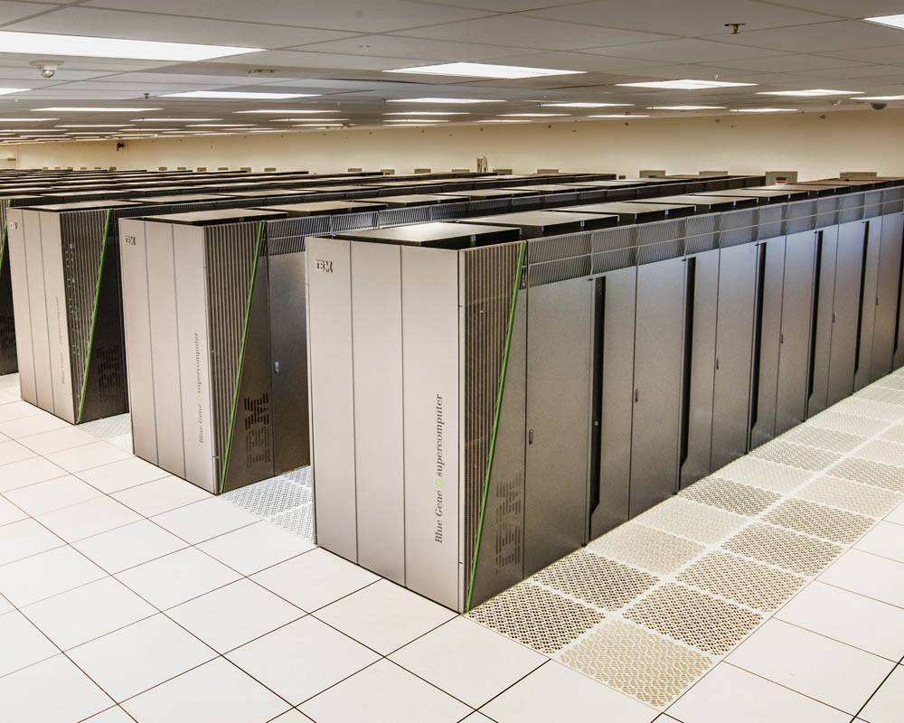
Sequoia
16.32 PFLOPS
98,304 nodes with 1,572,864 million cores 1.6 petabytes of memory
7.9 MWatts total power

Slide 50
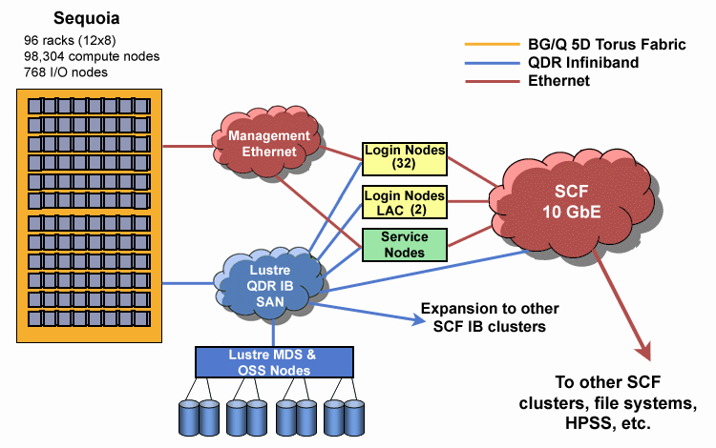
Source: LLNL

Slide 51
How do we get “big data” to the workers?
SAN
Compute Nodes
Why does this make sense for “traditional HPC”?
What’s the issue for “big data processing”?

Slide 52
What’s the solution?
Don’t move data to workers… move workers to the data!
Key idea: co-locate storage and compute
Start up worker on nodes that hold the data
SAN
Compute Nodes

Slide 53
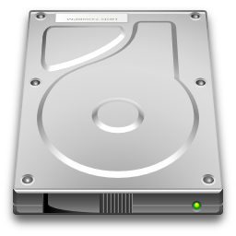
What’s the solution?
Don’t move data to workers… move workers to the data!
Key idea: co-locate storage and compute
Start up worker on nodes that hold the data
We need a distributed file system for managing this
GFS (Google File System) for Google’s MapReduce
HDFS (Hadoop Distributed File System) for Hadoop

Slide 54
GFS: Assumptions
Commodity hardware over “exotic” hardware
Scale “out”, not “up”
High component failure rates
Inexpensive commodity components fail all the time
“Modest” number of huge files
Multi-gigabyte files are common, if not encouraged
Files are write-once, mostly appended to
Logs are a common case
Large streaming reads over random access
Design for high sustained throughput over low latency
GFS slides adapted from material by (Ghemawat et al., SOSP 2003)

Slide 55
GFS: Design Decisions
Files stored as chunks
Fixed size (64MB)
Reliability through replication
Each chunk replicated across 3+ chunkservers
Single master to coordinate access and hold metadata
Simple centralized management
No data caching
Little benefit for streaming reads over large datasets
Simplify the API: not POSIX!
Push many issues onto the client (e.g., data layout)
HDFS = GFS clone (same basic ideas)

Slide 56
From GFS to HDFS
Terminology differences:
GFS master = Hadoop namenode
GFS chunkservers = Hadoop datanodes
Implementation differences:
Different consistency model for file appends
Implementation language
Performance
For the most part, we’ll use Hadoop terminology…

Slide 57
HDFS Architecture
HDFS namenode
Application
/foo/bar
(file name, block id)
File namespace
HDFS Client
block 3df2
(block id, block location)
instructions to datanode
(block id, byte range)
datanode state
HDFS datanode
HDFS datanode
block data
Linux file system
Linux file system
…
…
Adapted from (Ghemawat et al., SOSP 2003)

Slide 58
Namenode Responsibilities
Managing the file system namespace
Holds file/directory structure, file-to-block mapping, metadata (ownership, access permissions, etc.)
Coordinating file operations
Directs clients to datanodes for reads and writes
No data is moved through the namenode
Maintaining overall health
Periodic communication with the datanodes
Block re-replication and rebalancing
Garbage collection

Slide 59
k₁
v₁
k₂
v₂
k₃
v₃
k₄
v₄
k₅
v₅
k₆
v₆
map
map
map
map
a
1
b
2
c
3
c
6
a
5
c
2
b
7
c
8
combine
combine
combine
combine
a
1
b
2
c
9
a
5
c
2
b
7
c
8
partition
partition
partition
partition
Shuffle and Sort: aggregate values by keys
a
1
5
b
2
7
c
c
2
2
9
3
8
6
8
reduce
reduce
reduce
r₁
s₁
r₂
s₂
r₃
s₃

Slide 60
HDFS Architecture
HDFS namenode
Application
/foo/bar
(file name, block id)
File namespace
HDFS Client
block 3df2
(block id, block location)
instructions to datanode
(block id, byte range)
datanode state
HDFS datanode
HDFS datanode
block data
Linux file system
Linux file system
…
…
It’s a different file system – different set of commands!
Adapted from (Ghemawat et al., SOSP 2003)

Slide 61
Putting everything together…
namenode
job submission node
namenode daemon
jobtracker
tasktracker
tasktracker
tasktracker
datanode daemon
datanode daemon
datanode daemon
Linux file system
Linux file system
Linux file system
…
…
…
slave node
slave node
slave node
(Not Quite… We’ll come back to YARN later)

Slide 62

If you’re not (yet) registered…
Is there still hope?

Slide 63
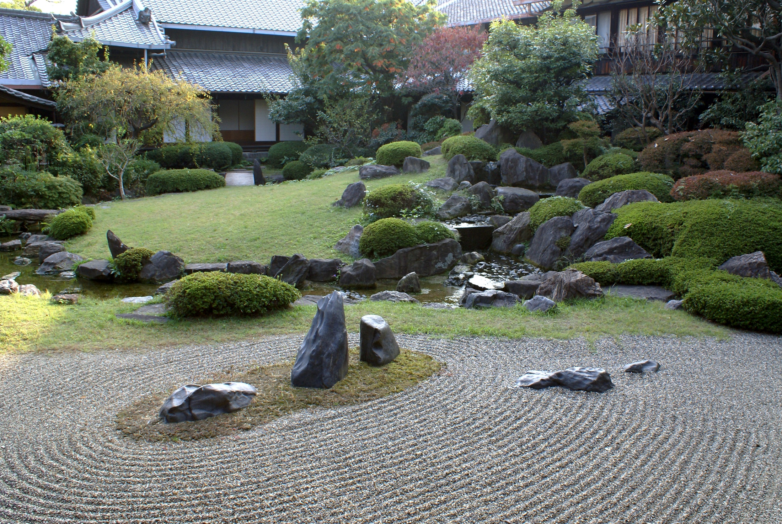
Questions?
Source: Wikipedia (Japanese rock garden)

